Slide 1
Class #7 – Part 1
Introduction no Noncooperative Game Theory:
Games in Normal Form

Slide 2






Motivation
Systems that include multiple autonomous entities with either diverging information or diverging interests, or both

Slide 3
Games
Which cell phone Cartman should pick?

Slide 4
Games
And now?

Slide 5

Billions
The Problem With Game Theory – The Philosophy of Billions - YouTube
Decisions Matter: Game Theory in Billions – Part I – Fan Fun with Damian Lewis

Slide 6
Motivation
Indeed, the Internet can be viewed as the ultimate platform for interaction among self-interested, distributed computational entities
Trading agents
“Interface agents” that facilitate the interaction between the user and various computational resources
Game-playing agents that assist (or replace) human players in a multiplayer game
Autonomous robots

Slide 7
Game Theory
Outcome of a person's decision depends not just on her preferences, but also on the choices made by others
Main question:
Which behaviors tend to sustain themselves when carried out in a larger population?

Slide 8

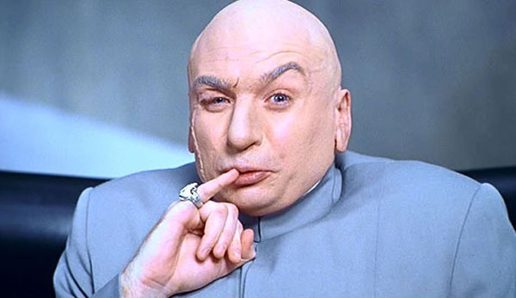
Self-Interested Agents
What does it mean?
They want to cause harm to each other?
Not necessarily!
They care only about themselves?
Not necessarily!

Slide 9
Self-Interested Agents
What does it mean?
Each agent has his own description of which states of the world he likes
which can include good things happening to other agents
and that he acts in an attempt to bring about these states of the world

Slide 10
Self-Interested Agents
A utility function is a mapping from states of the world to real numbers
measures of an agent’s level of happiness in the given states
If uncertain about which state of the world he faces
expected value of his utility function with respect to the appropriate probability distribution over states

Slide 11
Self-Interested Agents
The states can be thought of as the prizes in the context of lotteries

Slide 12
Example: friends and enemies
Alice has three options: club (c), movie (m), watching a video at home (h)
On her own, her utility for these three outcomes is 100 for c, 50 for m and 50 for h
Alice also cares about Bob (who she hates) and Carol (who she likes)
Bob is at the club 60% of the time, and at the movies otherwise
Carol is at the movies 75% of the time, and at the club otherwise
If Alice runs into Bob at the movies, she suffers disutility of 40; if she sees him at the club she suffers disutility of 90
If Alice sees Carol, she enjoys whatever activity she's doing 1.5 times as much as she would have enjoyed it otherwise

Slide 13
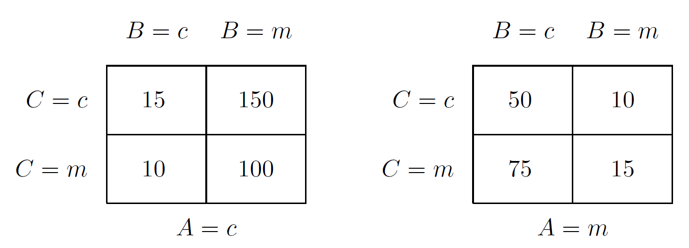
Example: friends and enemies
What should Alice do? Reminder: u(home) = 50
60%
40%
60%
40%
25%
75%
Alice chooses club
Alice chooses movie

Slide 14
Example: friends and enemies
What should Alice do? Reminder: u(home) = 50
60%
40%
60%
40%
25%
75%
Alice chooses club:
Eu(c) = 0.25(0.6 x 15 + 0.4 x 150) + 0.75(0.6 x 10 + 0.4 x 100) = 51.75
Alice chooses movies
Eu(m) = 0.25(0.6 x 50 + 0.4 x 10) + 0.75(0.6 x 75 + 0.4 x 15) = 46.75

Slide 15
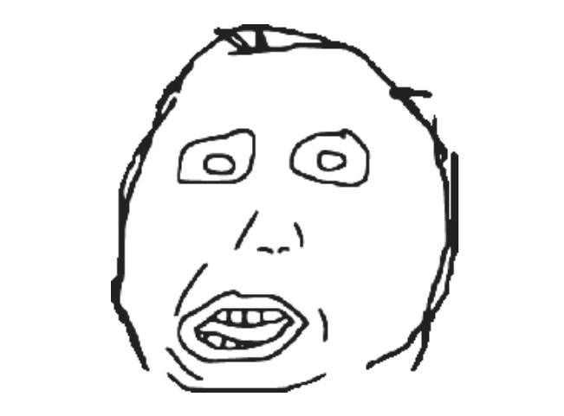
Example: friends and enemies
What should Alice do? Reminder: u(home) = 50
Alice prefers to go to the club (though Bob is often there and Carol rarely is), and prefers staying home to going to the movies (though Bob is usually not at the movies and Carol almost always is)
it makes sense...
Alice chooses club:
Eu(c) = 0.25(0.6 x 15 + 0.4 x 150) + 0.75(0.6 x 10 + 0.4 x 100) = 51.75
Alice chooses movies
Eu(m) = 0.25(0.6 x 50 + 0.4 x 10) + 0.75(0.6 x 75 + 0.4 x 15) = 46.75

Slide 16
What is a game? Example 1
Problem
You have an exam and a presentation tomorrow
You have time to prepare yourself for just one
The exam is individual and the presentation is together with a colleague
Which one should you pick?

Slide 17
What is a game? Example 1
Possible outcomes
Exam
If you study: 92
If you don't study: 80
Presentation
If both work: 100
If only one works: 92
If no one works: 84
The same outcomes are valid for your colleague

Slide 18
What is a game? Example 1
Possible outcomes (summary)
If you study and your colleague works on the presentation
(92 + 92) / 2 = 92
If you both study
(92 + 84) / 2 = 88
If you work on the presentation and your colleague studies
(80 + 92) / 2 = 86
If you both work on the presentation
(80 + 100) / 2 = 90

Slide 19
What is a game?
A set of players
you and your partner
A set of possible strategies for each player
to prepare for the presentation, or to study for the exam
A set of payoffs for each player and for each joint choice of strategies (the more, the better)
the average grade

Slide 20
Games in Normal Form
A (finite, n-person) normal-form game is a tuple (N,A,u), where:
N is a finite set of n players, indexed by i
A = A₁ × · · · × A_{n}, where A_{i} is a finite set of actions available to player i
Each vector a = (a₁, . . . , a_{n}) ∈ A is called an action profile
u = (u₁, . . . , u_{n}) where u_{i} : A → ℝ is a real-valued utility (or payoff) function for player i
u : A^{n} → ℝ^{n}

Slide 21
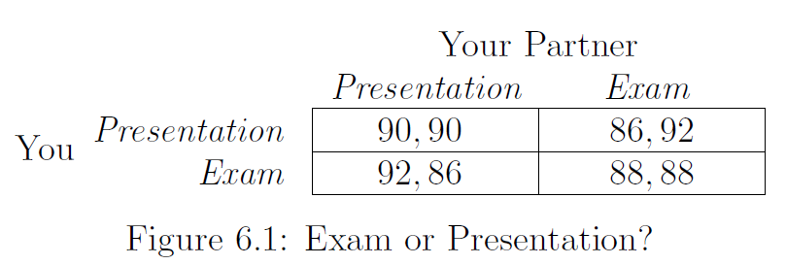
What is a game? Example 1

Slide 22
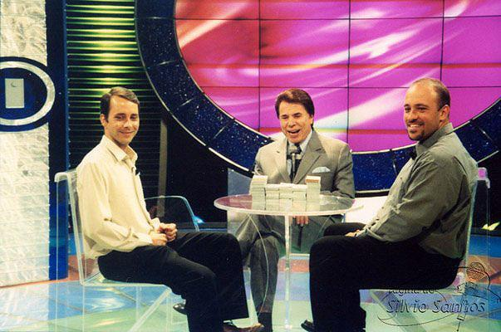
What is a game?
SÍLVIO SANTOS-PROGRAMA SETE E MEIO-DUAS EDIÇÕES JUNTOS -2002-MP4 - YouTube

Slide 23
What is a game? Example 1
Payoff Matrix

Slide 24
What is a game? Example 1
“Player 2” or “Column player”
“Player 1” or “Row player”

Slide 25
What is a game? Example 1
Strategies A₂ of Player 2
Strategies A₁ of Player 1

Slide 26
What is a game? Example 1
Payoffs of Player 1

Slide 27
What is a game? Example 1
Payoffs of Player 2

Slide 28
What is a game? Example 1
u(Exam, Presentation): The outcome of the game if P1 chooses 'Exam' and P2 chooses 'Presentation'
P2 gets 86
P1 gets 92

Slide 29
Reasoning about Behavior in a Game
Everything that a player cares about is summarized in the player's payoffs
If a player is altruistic, the payoffs should reflect it

Slide 30
Reasoning about Behavior in a Game
Each player knows everything about the structure of the game
her own list of possible strategies
who the other players are
the strategies available to them
what his or her payoff will be for any choice of strategies
There are many studies on games with incomplete information

Slide 31
Reasoning about Behavior in a Game
Rationality
each player wants to maximize her own payoff
each player actually succeeds in selecting the optimal strategy
Achieved usually with time and/or a lot of reasoning

Slide 32
Reasoning about Behavior in the Exam-or-Presentation Game

Slide 33
Reasoning about Behavior in the Exam-or-Presentation Game
if you knew your partner was going to study for the exam:
88 by also studying
86 by preparing for the presentation
Decision: you should study for the exam

Slide 34
Reasoning about Behavior in the Exam-or-Presentation Game
if you knew your partner was going to work on the presentation:
90 by also working
92 by studying
Decision: you should study for the exam

Slide 35
Reasoning about Behavior in the Exam-or-Presentation Game
No matter what your partner does, you should study for the exam

Slide 36
Strictly Dominant Strategy
A strategy that is strictly better than all other options regardless of what the other player does
To study for the exam

Slide 37
Strictly Dominant Strategy
It does not mean it will give the best payoff!

Slide 38
Strictly Dominant Strategy
It does not mean it will give the best payoff!
Even if we agree to work on the presentation together, I have a clear incentive to deviate
92 > 90

Slide 39
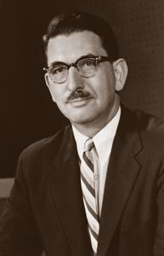
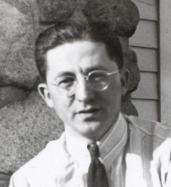
The Prisoner's Dilemma
Proposed by Flood and Dresher while working at RAND in 1950
Merrill Flood
Melvin Dresher

Slide 40
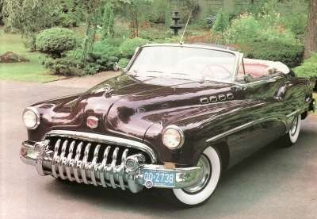
The Prisoner's Dilemma
In June 1949, Flood wanted to buy a used Buick from a RAND employee who was moving back East

Slide 41
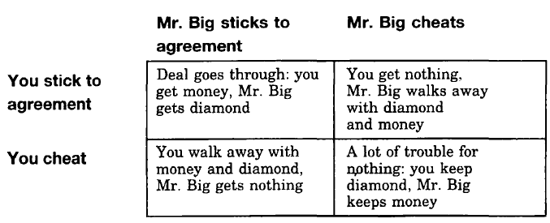
The Prisoner's Dilemma
Honor among thieves

Slide 42
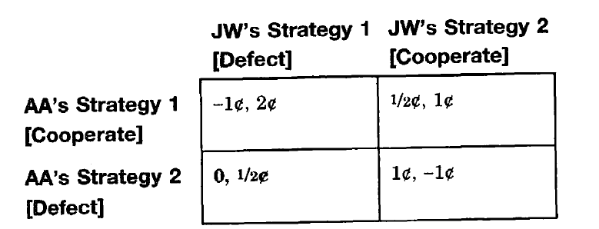
The Prisoner's Dilemma
The Flood Dresher's experiment
Armen Alchian (AA) vs. John D. Williams (JW)

Slide 43
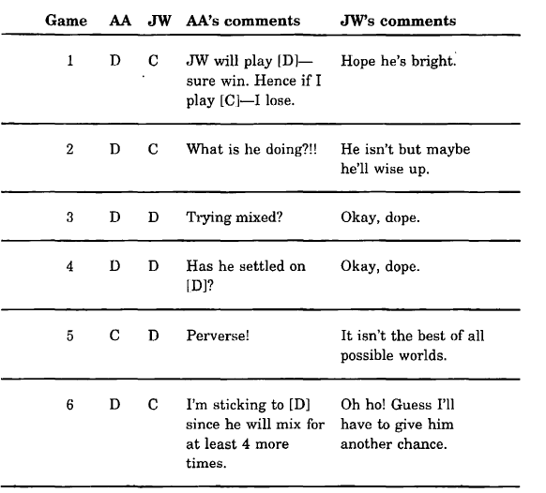
Armen Alchian vs. John D. Williams

Slide 44
The Prisoner's Dilemma
Two suspects are being interrogated in separate rooms.
The police strongly suspect that these two individuals are responsible for a robbery, but there is not enough evidence to convict either of them of the robbery. However, they both resisted arrest and can be charged with that lesser crime, which would carry a one-year sentence.
Each of the suspects is told the following story. If you confess, and your partner doesn't confess, then you will be released and your partner will be charged with the crime. Your confession will be sufficient to convict him of the robbery and he will be sent to prison for 10 years. If you both confess, then we don't need either of you to testify against the other, and you will both be convicted of the robbery. (Although in this case your sentence will be 4 years only because of your guilty plea.) If neither of you confesses, then we can't convict either of you of the robbery, so we will charge each of you with resisting arrest (1 year). Your partner is being offered the same deal.
Do you want to confess?

Slide 45
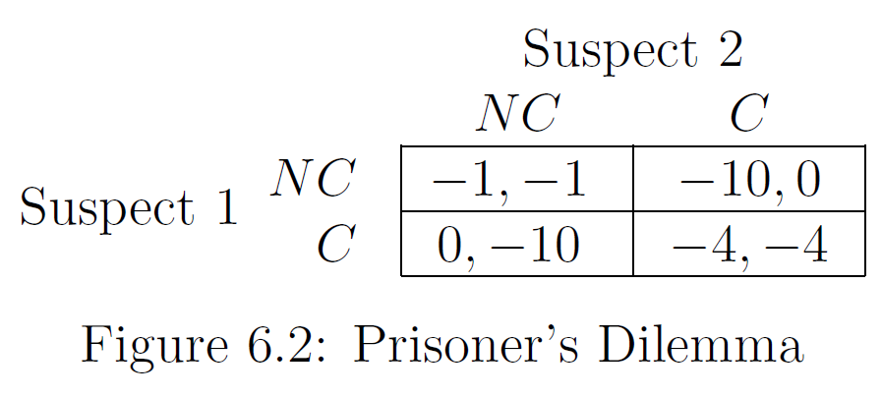
The Prisoner's Dilemma

Slide 46
The Prisoner's Dilemma
If P2 confesses:
if P1 does not confess: -10
if P1 confesses: -4
Decision: to confess

Slide 47
The Prisoner's Dilemma
If P2 does not confess:
if P1 does not confess: -1
if P1 confesses: 0
Decision: to confess

Slide 48
The Prisoner's Dilemma
The strategy “to confess” strictly dominates the strategy “to not confess” for both players

Slide 49
The Prisoner's Dilemma
It serves as a highly streamlined depiction of the difficulty in establishing cooperation in the face of individual self-interest
Are there other real-world situations?
Performance enhancing drugs in sports
Arms race between opposing nations
etc

Slide 50
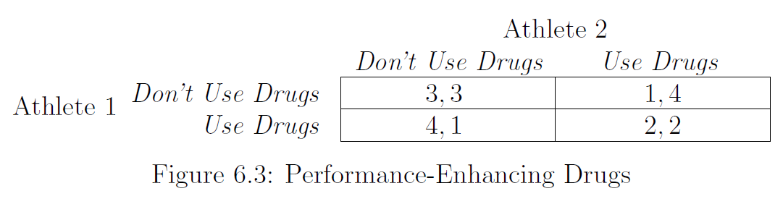
The Prisoner's Dilemma

Slide 51
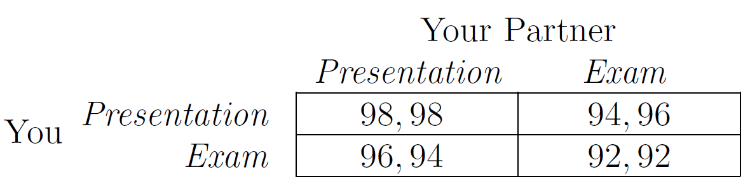
The Prisoner's Dilemma
It only manifests itself when the conditions are right
Making the exam easier, i.e., 100 if you study, 96 if you do not

Slide 52
Let's go back to school...
You and your partner are preparing slides for a joint project presentation
You can't reach your partner by phone and need to start working on the slides now
You have to decide whether to prepare your half of the slides in PowerPoint or in Apple's Keynote software
it will be much easier to merge your slides together with your partner's if you use the same software

Slide 53
Common payoff games (pure coordination games)
A common payoff game is a game in which for all action profiles a ∈ A₁ × · · · × A_{n} and any pair of agents i, j, it is the case that u_{i}(a) = u_{j}(a)

Slide 54
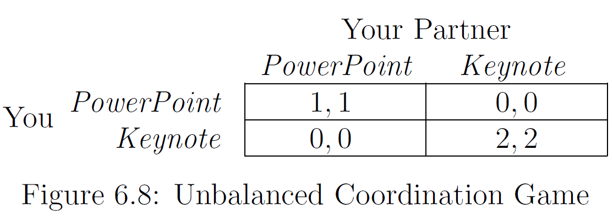
Common payoff games (pure coordination games)
Suppose that both you and your project partner each prefer Keynote to PowerPoint

Slide 55
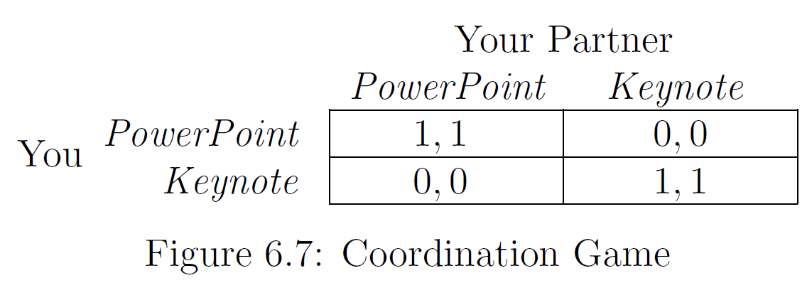
Common payoff games (pure coordination games)
Suppose that both you do not care about which software you use

Slide 56
Common payoff games (pure coordination games)
Examples?

Slide 57
Common payoff games (pure coordination games)
Examples
two manufacturing companies that work together extensively need to decide whether to configure their machinery in metric units of measurement or English units of measurement
two platoons in the same army need to decide whether to attack an enemy's left flank or right flank
two people trying to find each other in a crowded mall need to decide whether to wait at the north end of the mall or at the south end
Both choices can be fine, provided that both participants make the same choice

Slide 58
Common payoff games (pure coordination games)
Two people unable to communicate with each other are asked to select a square in a four-square panel
If and only if both select the same one, they will each receive a prize

Slide 59
Common payoff games (pure coordination games)
Select a square in the panel
If and only if both select the same one, they will each receive a prize
A | B
C | D

Slide 60

Schelling's Focal Point
"Focal point[s] for each person’s expectation of what the other expects him to expect to be expected to do"

Slide 61
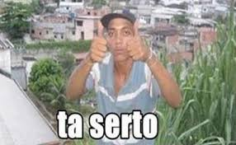
Schelling's Focal Point
"Focal point[s] for each person’s expectation of what the other expects him to expect to be expected to do"

Slide 62
Schelling's Focal Point
It is a solution that people will tend to use in the absence of communication, because it seems natural, special, or relevant to them
Such points are highly useful in negotiations, because we cannot completely trust our negotiating partners' words

Slide 63
Constant-sum games (zero-sum games)
A two-player normal-form game is constant sum if there exists a constant c such that for each strategy profile a ∈ A₁ × A₂ it is the case that u₁(a) + u₂(a) = c
For convenience, assume that c=0, that is, that we have a zero-sum game
Does it make any difference?

Slide 64
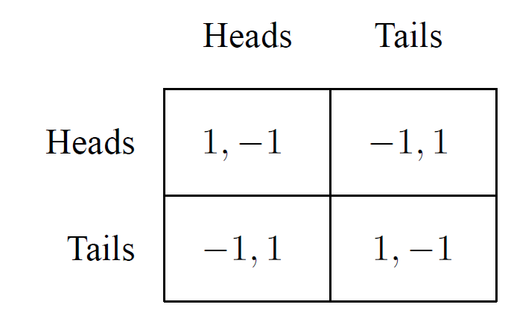
Constant-sum games (zero-sum games)
Matching pennies

Slide 65
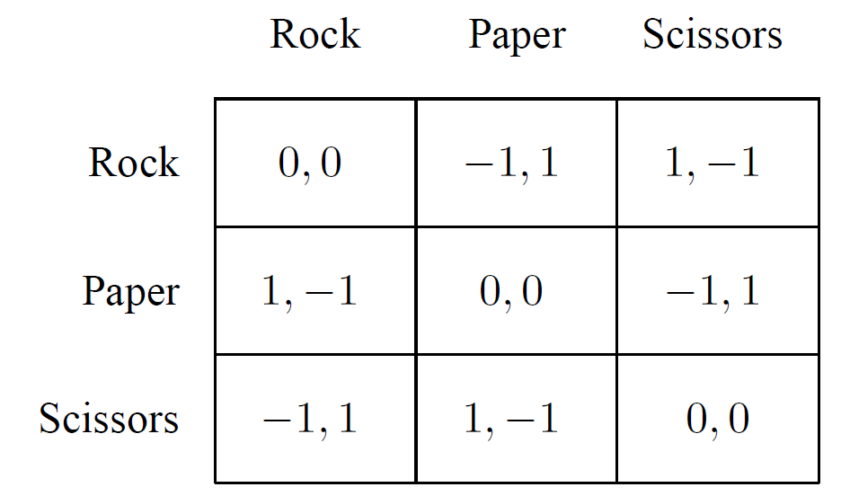
Constant-sum games (zero-sum games)
Rock, paper, scissors

Slide 66
Hybrid games
In general, games can include elements of both coordination and competition
Prisoner’s Dilemma?

Slide 67
Hybrid games
Battle of the sexes
Husband and wife wish to go to the movies, and they can select among two movies:
“Lethal Weapon (LW)” and “Wondrous Love (WL)”
They much prefer to go together rather than to separate movies, but while the wife (player 1) prefers LW, the husband (player 2) prefers WL

Slide 68
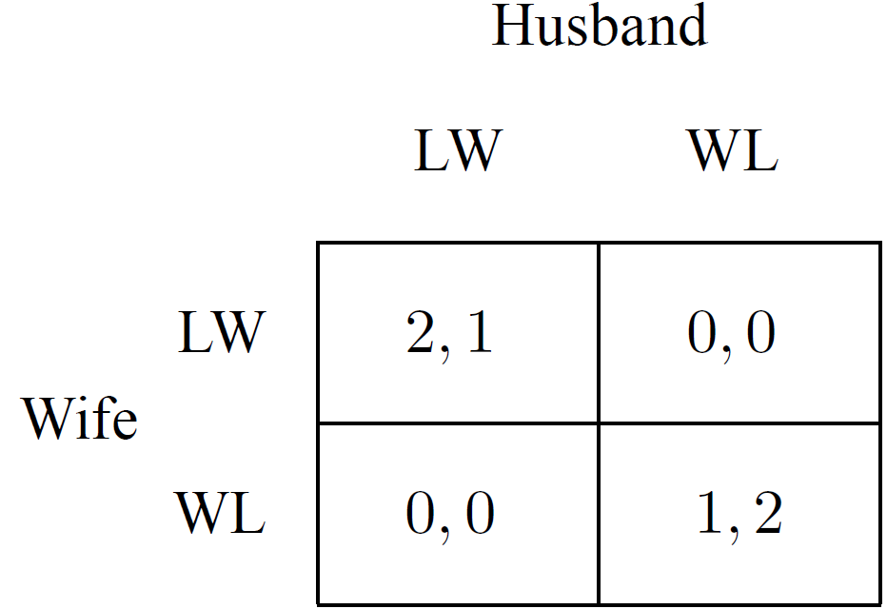
Hybrid games
Battle of the sexes

Slide 69
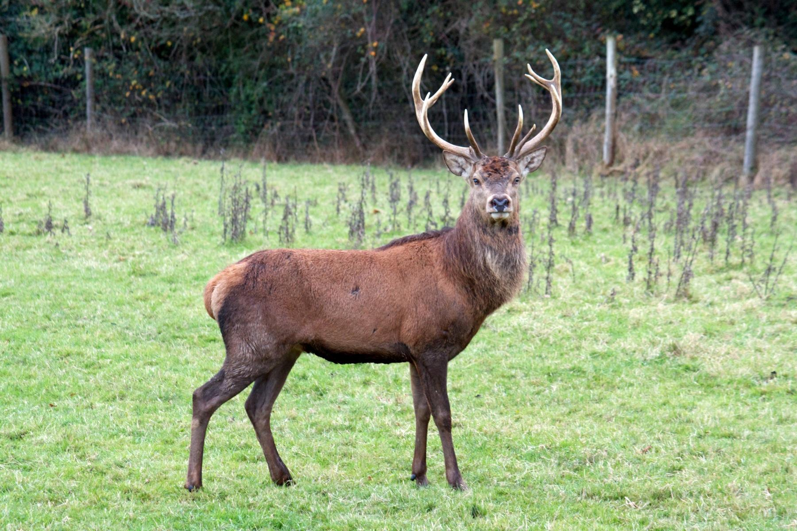

Variants on the Basic Coordination Game
Suppose that two people are out hunting
If they work together, they can catch a stag (which would be the highest-payoff outcome)
but on their own each can catch a hare

Slide 70
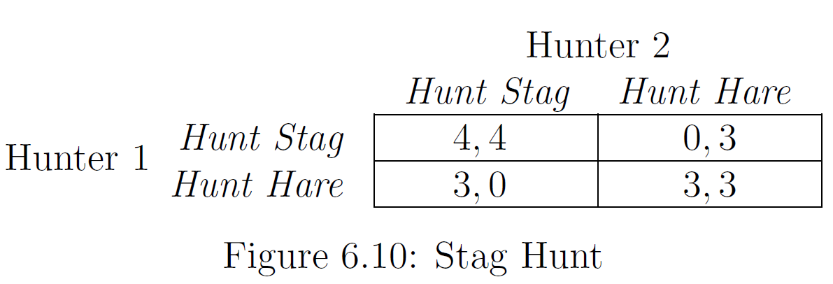
Variants on the Basic Coordination Game

Slide 71
Variants on the Basic Coordination Game
Similar to the Unbalanced Coordination Game
Except that if the two players miscoordinate:
the one who was trying for the higher-payoff outcome gets penalized more than the one who was trying for the lower-payoff outcome

Slide 72
Constant-sum games (zero-sum games)
Which action should I play?

Slide 73
Strategies in Normal Form Games
It would be a pretty bad idea to play any deterministic strategy in matching pennies
Heads is so much
better than Tails

Slide 74
Strategies in Normal Form Games
Idea: confuse the opponent by playing randomly
Define a strategy s_{i} for agent i as any probability distribution over the actions A_{i}
pure strategy: only one action is played with positive probability
mixed strategy: more than one action is played with positive probability

Slide 75
Strategies in Normal Form Games
Idea: confuse the opponent by playing randomly
for any set X let ∏(X) be the set of all probability distributions over X
Let the set of all strategies for i be S_{i} = ∏(A_{i})
Let the set of all strategy profiles be S = S₁ ⨯ ... ⨯ S_{n}

Slide 76
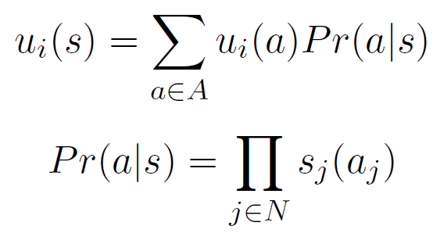
Strategies in Normal Form Games
What is your payoff if all the players follow mixed strategy profile s ∈ S?
We can't just read this number from the game matrix anymore
we won't always end up in the same cell
We use the idea of expected utility from decision theory:

Slide 77

Strategies in Normal Form Games
Matching pennies
s = (s₁, s₂)
s = ( (0.8,0.2), (0.4,0.6) )
Pr(a|s) = ∏_{j∈N}s_{j}(a_{j})
Pr( (H,H) |s) = 0.8 x 0.4
Pr( (H,T) |s) = 0.8 x 0.6
Pr( (T,H) |s) = 0.2 x 0.4
Pr( (T,T) |s) = 0.2 x 0.6
s₂(H) = 0.4
s₂(T) = 0.6
s₁(H) = 0.8
0.32
0.48
u₁(s) = Σ_{a∈A}u₁(a)Pr(a|s)
u₁(s) = 0.32(1) + 0.48(-1) + 0.08(-1) + 0.12(1)
u₁(s) = -0.12
u₂(s) = +0.12
0.08
0.12
s₁(T) = 0.2

Slide 78
Solving a Game
What is an optimal strategy for a given agent?
The best strategy depends on the choices of others

Slide 79
Solving a Game
Solution concepts
Certain subsets of outcomes that are interesting in one sense or another
Pareto optimality
Nash equilibrium

Slide 80
Analyzing a Game
Can some outcomes of a game be said to be better than others?
 | L | R
U | 1, 1000 | 0,0
D | 2,1 | 1, 0

Slide 81
Analyzing a Game
Can some outcomes of a game be said to be better than others?
We have no way of saying that one agent's interests are more important than another's
E.g., multiply player 1’s payoffs by 1,000 to change the sum of agents’ utilities
Intuition: we don't know what currency has been used to express each agent's payoffs

Slide 82
Analyzing a Game
Are there situations where we can still prefer one outcome to another?

Slide 83
Pareto Domination
Idea: sometimes, one outcome o is at least as good for every agent as another outcome o', and there is some agent who strictly prefers o to o'
In this case, it seems reasonable to say that o is better than o'
We say that o Pareto-dominates o'

Slide 84
Pareto Domination
Strategy profile s Pareto dominates strategy profile s′ if for all i ∈ N, u_{i}(s) ≥ u_{i}(s′), and there exists some j ∈ N for which u_{j}(s) > u_{j}(s′)
Observe that we define Pareto domination over strategy profiles, not just action profiles

Slide 85
Pareto Optimality
An outcome o is Pareto-optimal if there is no other outcome o' that Pareto-dominates it
or
A strategy profile s is Pareto-optimal if there does not exist another strategy profile s′ ∈ S that Pareto dominates s
Can a game have more than one Pareto-optimal outcome?
Does every game have at least one Pareto-optimal outcome?

Slide 86
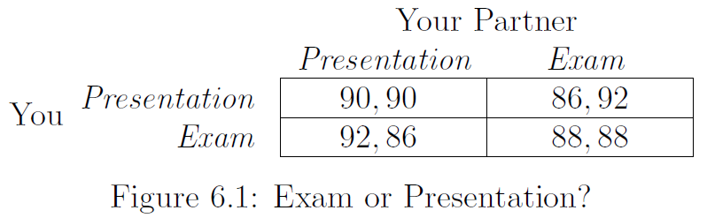
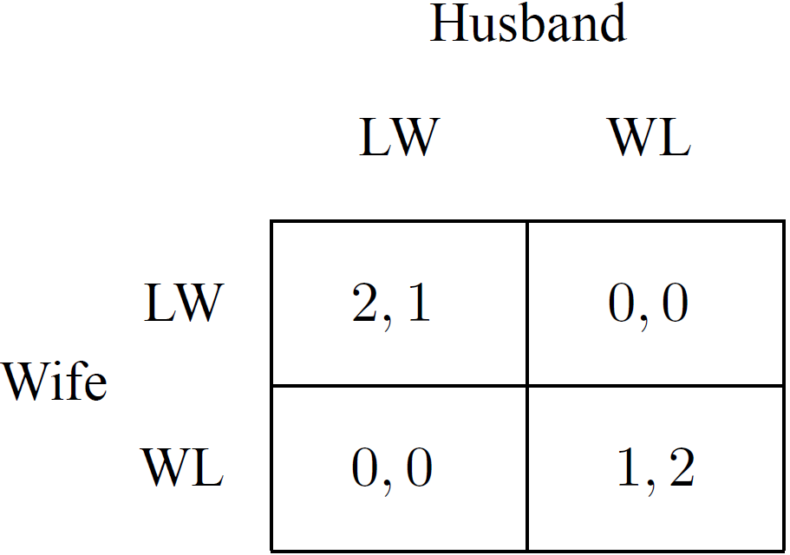
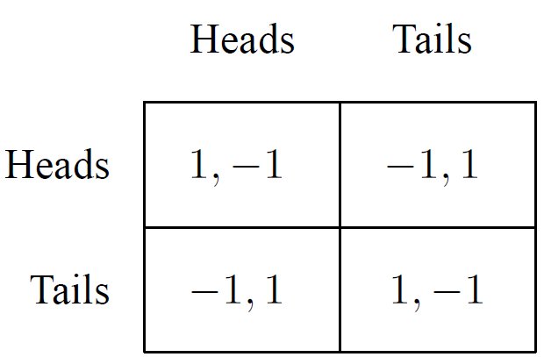
Pareto Optimality

Slide 87
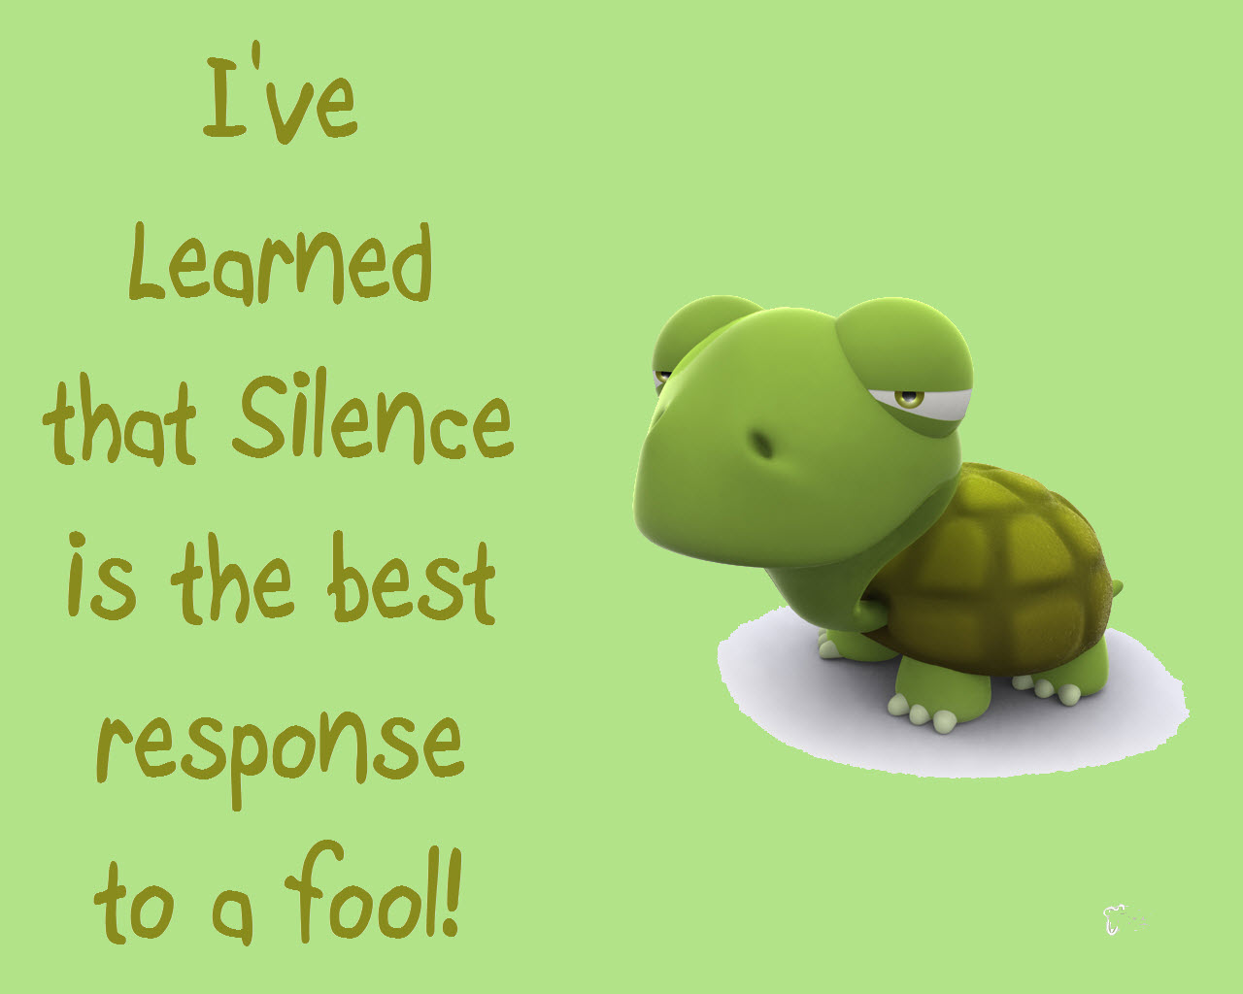
Best Response

Slide 88
Best Response
Best response
it is the best choice of one player, given a belief about what the other player will do
in the Exam-or-Presentation Game, we determined your best choice in response to each possible choice of your partner

Slide 89
Best Response
If you knew what everyone else was going to do, it would be easy to pick your own action
Player i’s best response to the strategy profile s_{−i} is a mixed strategy s_{i}∗ ∈ S_{i} such that
u_{i}(s_{i}∗ , s_{−i}) ≥ u_{i}(s_{i}, s_{−i}) for all strategies s_{i} ∈ S_{i}
Best responses are unique?
s_{i}∗ ∈ BR(s_{−i}) iff ∀ s_{i} ∈ S_{i} , u_{i}(s_{i}∗ , s_{−i}) ≥ u_{i}(s_{i}, s_{−i})

Slide 90
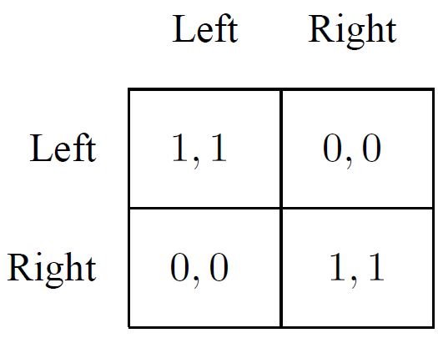
Best Response
Best responses are unique?
If player 2's strategy is s₂ = (0.5,0.5), what is your best response?
s₁ = (0.5,0.5), u₁(s) = 0.25(1+0+0+1) = 0.5
s₁ = (0.75,0.25), u₁(s) = 0.5
s₁ = (0.38,0.62), u₁(s) = 0.5

Slide 91
Best Response
Best responses are unique?
It is unique when there is a unique best response that is a pure strategy
s₂ = (1,0)
s₂ = (0.8,0.2)

Slide 92
Best Response
Best response is not a solution concept
Does not identify an interesting set of outcomes
However, we can leverage the idea of best response to define what is arguably the most central notion in non-cooperative game theory

Slide 93
Nash Equilibrium
Imagine a setting where no agent knows anything about what the others will do
What can we say about which actions will occur?
Idea: look for stable action profiles

Slide 94
An Example: A Three-Client Game
Suppose there are two firms that each hope to do business with one of three large clients, A, B, and C
Each firm has three possible strategies: whether to approach A, B, or C

Slide 95
An Example: A Three-Client Game
If the two firms approach the same client, then the client will give half its business to each
Firm 1 is too small to attract business on its own, so if it approaches one client while Firm 2 approaches a different one, then Firm 1 gets a payoff of 0
If Firm 2 approaches client B or C on its own, it will get their full business

Slide 96
An Example: A Three-Client Game
However, A is a larger client, and will only do business with the firms if both approach A
Because A is a larger client, doing business with it is worth 8 (and hence 4 to each firm if it's split), while doing business with B or C is worth 2 (and hence 1 to each firm if it's split)

Slide 97
An Example: A Three-Client Game
If the two firms approach the same client, then the client will give half its business to each
Firm 1 is too small to attract business on its own, so if it approaches one client while Firm 2 approaches a different one, then Firm 1 gets a payoff of 0
If Firm 2 approaches client B or C on its own, it will get their full business
However, A is a larger client, and will only do business with the firms if both approach A
Because A is a larger client, doing business with it is worth 8 (and hence 4 to each firm if it's split), while doing business with B or C is worth 2 (and hence 1 to each firm if it's split)

Slide 98
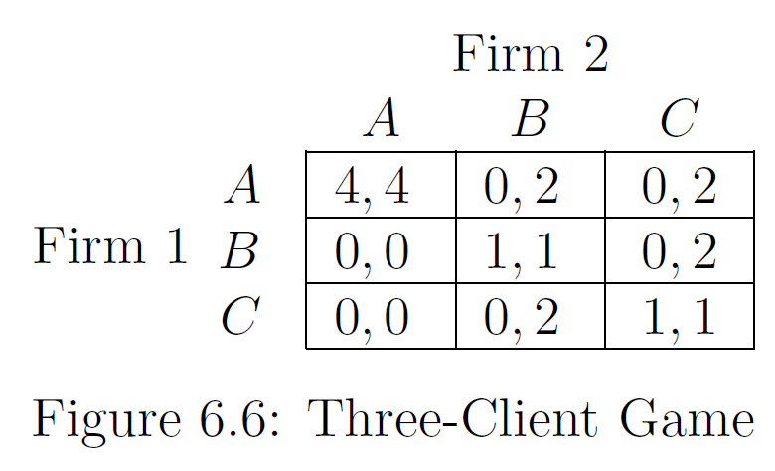
An Example: A Three-Client Game

Slide 99
An Example: A Three-Client Game

Slide 100

Defining Nash Equilibrium
John Nash proposed a simple but powerful principle for reasoning about behavior in general games
Even when there are no dominant strategies, we should expect players to use strategies that are best responses to each other

Slide 101
Defining Nash Equilibrium
A pair of strategies (s_{i}; s_{j}) is a Nash equilibrium if s_{i} is a best response to s_{j}, and s_{j} is a best response to s_{i}
If the players choose strategies that are best responses to each other, then no player has an incentive to deviate to an alternative strategy
The system is in a kind of equilibrium state, with no force pushing it toward a different outcome

Slide 102
Defining Nash Equilibrium

Slide 103
Defining Nash Equilibrium
(A; A) is a Nash Equilibrium

Slide 104
Pure Strategy Nash Equilibrium
A strategy profile a = (a₁, . . . , a_{n}) is a pure strategy Nash equilibrium if, for all agents i, a_{i} is a best response to a_{−i}
a = (a₁, ..., a_{n}) is a pure strategy Nash equilibrium iff ∀i, a_{i} ∈ BR(a_{-i})
Intuitively, a Nash equilibrium is a stable strategy profile: no agent would want to change his strategy if he knew what strategies the other agents were following

Slide 105
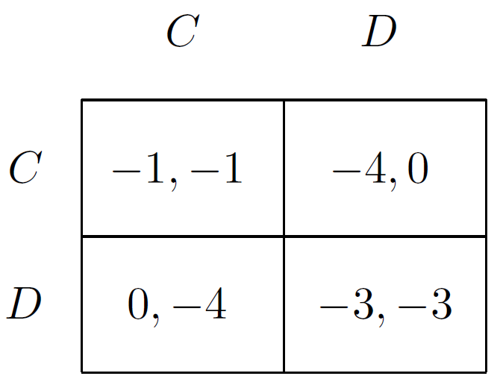
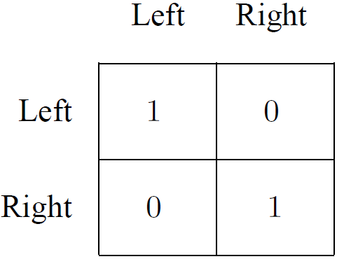
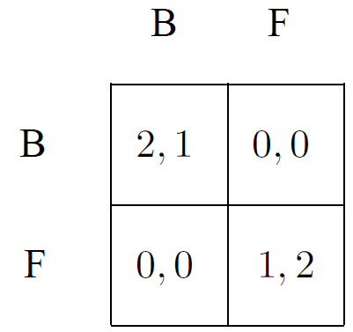
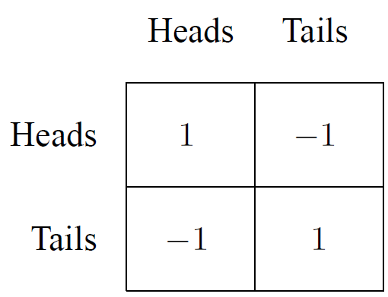
Pure Strategy Nash Equilibrium

Slide 106
Pure Strategy Nash Equilibrium
How to find?
To check all pairs of strategies, and ask for each one of them whether the individual strategies are best responses to each other
To compute each player's best response(s) to each strategy of the other player, and then find strategies that are mutual best responses

Slide 107
Nash Equilibrium
What is your payoff if all the players follow a mixed strategy profile s ∈ S?
We can't just read this number from the game matrix anymore: we won't always end up in the same cell

Slide 108
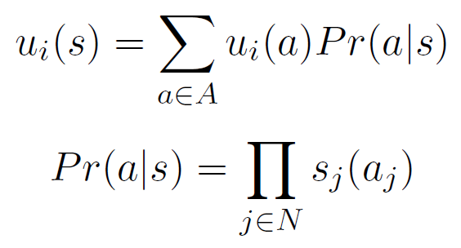
Nash Equilibrium
We use the idea of expected utility from decision theory:

Slide 109
Nash Equilibrium
A strategy profile s = (s₁, . . . , s_{n}) is a Nash equilibrium if, for all agents i, s_{i} is a best response to s_{−i}
Intuitively, a Nash equilibrium is a stable strategy profile: no agent would want to change his strategy if he knew what strategies the other agents were following

Slide 110
Nash Equilibrium
A strategy profile s = (s₁, . . . , s_{n}) is a strict Nash equilibrium if, for all agents i and for all strategies s_{i}′ ≠ s_{i}, u_{i}(s_{i}, s_{−i}) > u_{i}(s_{i}′, s_{−i})
A strategy profile s = (s₁, . . . , s_{n}) is a weak Nash equilibrium if, for all agents i and for all strategies s_{i}′ ≠ s_{i}, u_{i}(s_{i}, s_{−i}) ≥ u_{i}(s_{i}′, s_{−i}) and s is not a strict Nash equilibrium

Slide 111

Nash Equilibrium
Theorem (Nash, 1951)
Every game with a finite number of players and action profiles has at least one Nash equilibrium
with mixed strategies

Slide 112
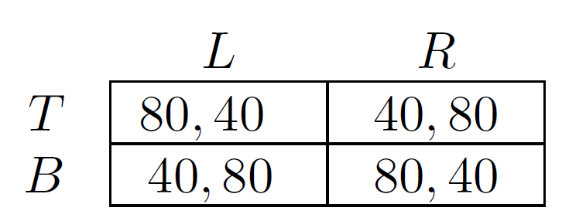
Fun Game
Notes:
TR, 2024/01 +1

Slide 113
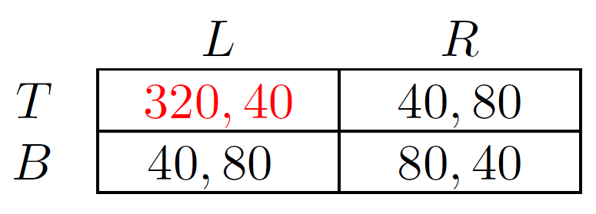
Fun Game

Slide 114
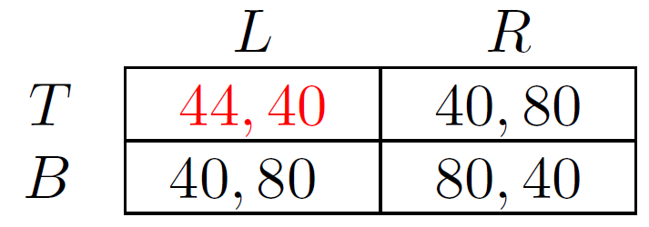
Fun Game

Slide 115
Fun Game
What does row player do in equilibrium of this game?
row player randomizes 50-50 all the time
that's what it takes to make column player indifferent
What happens when people play this game?
with payoff of 320, row player goes up essentially all the time
with payoff of 44, row player goes down essentially all the time

Slide 116
Mixed strategies
Some counter-intuitive features...
Do people really play them?
Heads: pizza
Tails: burger

Slide 117
Mixed strategies
Ignacio Palacios-Heurta (2003) “Professionals Play Minimax” Review of Economic Studies, Volume 70, pp 395-415
1417 Penalty kicks from FIFA games: Spain, England, Italy...
Ignacio considers left, center, or right choices, and considered which leg the kicker used
I will keep it down to left and right choices ignoring kicker’s leg

Slide 118
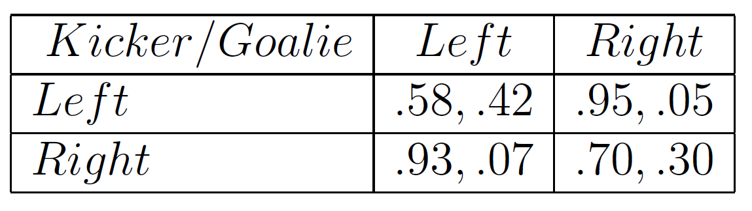
Mixed strategies
u_{i}(s) = empirical probability of winning

Slide 119
Mixed strategies
Let's solve the game...
0.58q + 0.95(1-q) = 0.93q + 0.70(1-q)
q = 0.42
0.42p + 0.07(1-p) = 0.05p + 0.30(1-p)
p = 0.38
q
1-q
p
1-p

Slide 120
Mixed strategies
Let's solve the game...
q = 0.42, p = 0.38
Do players randomize accordingly?
q
1-q
p
1-p

Slide 121
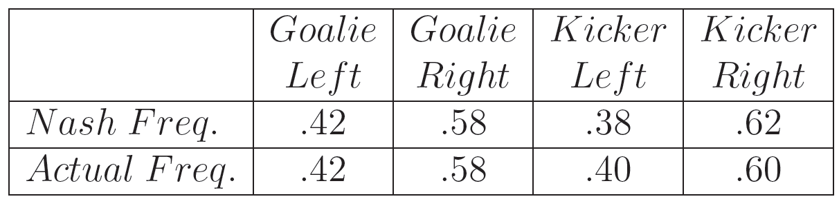
Mixed strategies

Slide 122
Mixed strategies

Slide 123
Mixed strategies
Do players randomize well over time?
Pretty well...
How about under pressure? Do they become predictable?
Statisticians/Game Theorists are being hired to keep watch this
Other sports
Tennis players and serves, M. Walker and J. Wooders, American Economic Review (2001) “Minimax Play and Wimbeldon” volume 91, pp 1521-1538

Slide 124
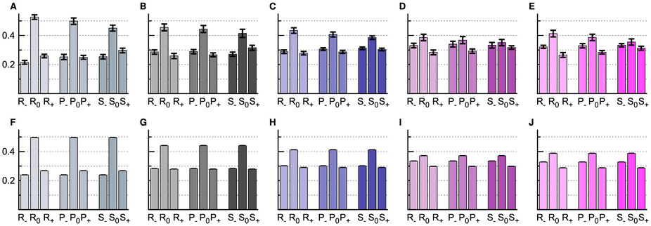
Mixed strategies
Social cycling and conditional responses in the Rock-Paper-Scissors game Zhijian Wang, Bin Xu & Hai-Jun Zhou Scientific Reports 4, Article number: 5830 (2014)

Slide 125
Mixed strategies
Important note about mixed strategies:
since players are able to receive any linear combination of their utility values, then all values must be defined very carefully
should respect preference relations over lotteries!

